Slide 1
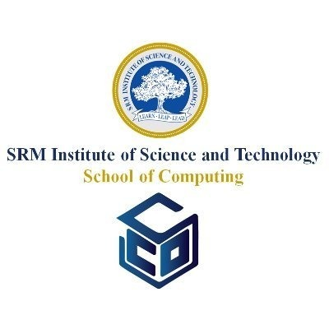
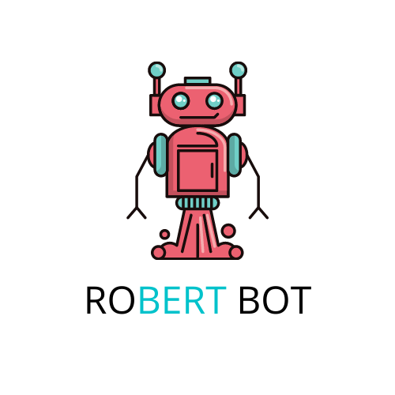
GRU based Seq2Seq Chatbot
Aakash Kaushik - RA1911032010001
Parikshit Kumar - RA1911032010002
Aryan Kargwal - RA1911032010023
Aditya Choudhury - RA1911032010021

Slide 2
Problem
To create a versatile, deployable non rule based chatbot.
Used to answer user queries in bulk to handle multiple users at the same time.
The chatbot can be further used for tasks like medical help where people have certain kind of disabilities like blindness, missing limbs, etc…
Integrating the chatbot into large scale services for quick and easy help to people using the service.
Importance
A simple and user friendly UI around user queries.
Versatility to handle different type of natural sentences.
Modularity in the components to make easy changes without interfering with other parts.
Simple solution to all immediate assistance needs.
Training data for special and medical use cases, Data of those sorts is hard to collect and ask for due to private information.
Technique
The problem was to tackle the needs of people who cannot type or see.
We came up with TTS modules (text to speech and vice-versa) to help them.
Second we needed a brain that could take up the transformed sentences and produce good results so we used GRU units which are a type of recurrent neural networks.
The type of architecture is a encoder decoder architecture which models sequences to other sequences.
Dataset
Cornell movies dialogs
This corpus contains a large metadata-rich collection of fictional conversations extracted from raw movie scripts:
220,579 conversational exchanges between 10,292 pairs of movie characters
involves 9,035 characters from 617 movies
in total 304,713 utterances
movie metadata included:
Genres
release year
IMDB rating
number of IMDB votes
IMDB rating
character metadata included:
gender (for 3,774 characters)
position on movie credits (3,321 characters)

Slide 3
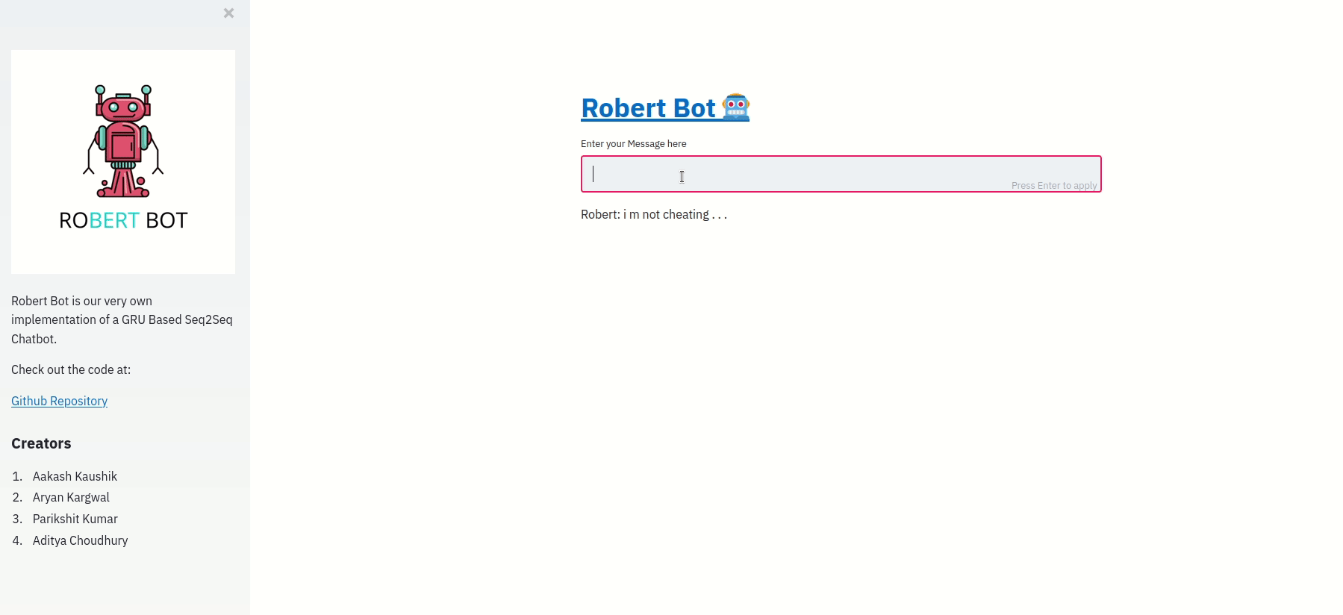
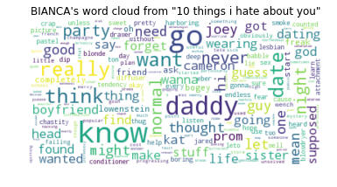
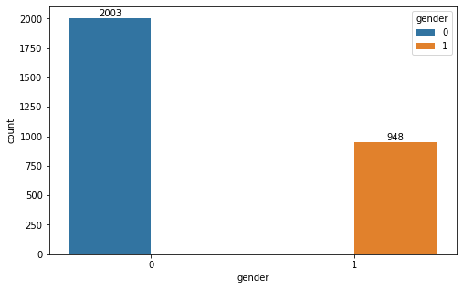
Inferences
Robert takes in an input in the form of a text sentence typed in by the user
Takes approximately 1.5 seconds for Robert to reply with a text based output based on the movie corpus it has been trained on
Robert takes approximately 2 seconds from input to reply with a voice output based on the text output it has produced
The corpus has a tendency for gender bias, leans more towards male dialogue conversation
The chatbot itself is easily accessible on Heroku and has a simplistic interface which makes it very convenient to use
This makes robert lightweight and versatile
Graphs - Visualization
Frontend using streamlit
Word clouds Generated by Robert on the movie corpus:
Gender representation in the corpus after feature Engineering (1 is female):
Results
A non rule based chatbot has been successfully implemented along with efficient use of the movie corpus
Robert has been successfully integrated into the web with a fully functional front-end.
Robert is capable of taking in a user’s text input and responding.
Robert is capable of producing appropriate replies which are then converted to voice output successfully.
Robert needs better fine tuning for more specialised responses in case of medical tasks.
With a speech to text engine, Robert should be more than ready to be used as a therapy bot for people that are not capable of body movement.
Future
Enhancements
More specialised data is required in general for Robert to produce better results
The gender bias in the corpus needs to be reduced significantly
Data focused on medical responses will need to be acquired for Robert to function as a medical assistance bot.
Longer training for more accurate responses.
A voice to text for more convenient input for people with disabilities.
GITHUB LINK

Slide 4
THANK YOU

